Slide 1

Mini Project: Doctor-Patient Application
20CS2016 – Database Management Systems
By: Jonathan Thomas Mathews URK21CS2036

Slide 2

Database Management Systems
A Database Management System (DBMS) is a software system that enables the creation, maintenance, and management of databases. It provides a structured way to store, retrieve, and manipulate data efficiently. DBMSs serve as intermediaries between users and the database, allowing users to interact with data without needing to understand the underlying data structures. Key features of DBMSs include data storage, retrieval, indexing, security, and support for querying and transactions.
DBMSs can be broadly categorized into two types:
Relational DBMS (RDBMS): These systems organize data into tables with rows and columns, providing a structured way to store and query data. Popular RDBMSs include MySQL, PostgreSQL, Oracle, and Microsoft SQL Server.
NoSQL Databases: NoSQL databases are more flexible and suitable for handling unstructured or semi-structured data. They are commonly used in modern web applications for their ability to scale and adapt to changing data requirements. Examples include MongoDB, Cassandra, and Redis.

Slide 3
Motivation
The motivation behind developing the Doctor-Patient Database project is to streamline and enhance the management of medical records and improve patient care. Here are some key motivations:
Efficient Data Management: Doctors and healthcare providers can quickly access patient information, reducing administrative overhead.
Data Security: Storing medical records in a centralized and secure database helps ensure the confidentiality and integrity of patient data.
Reporting and Analysis: The system allows doctors to generate detailed medical reports for patients. These reports provide valuable insights into a patient's health and can be crucial for diagnosis and treatment planning.
Patient Convenience: Patients can access their own records, reducing the need for physical paperwork. This convenience can improve patient engagement and satisfaction.
Data Accuracy: A well-maintained medical database can help reduce errors in patient records. Accurate and up-to-date information is critical for delivering quality healthcare.
Scalability: This project can be a foundation for expanding the database to handle a larger number of patients and healthcare providers.
Research and Analysis: The data collected in the database can be a valuable resource for medical research, clinical trials, and epidemiological studies.

Slide 4

Problem Statement
The problem statement is to develop a medical database management system with a graphical user interface (GUI) that serves both doctors and patients. The primary objectives and requirements for this system are as follows:
User Authentication, Doctor Functionality, Patient Functionality, Data Management, Data Validation, GUI Interface, Database Connectivity, Error Handling, Report Generation, Doctor-Patient Interaction, Security

Slide 5


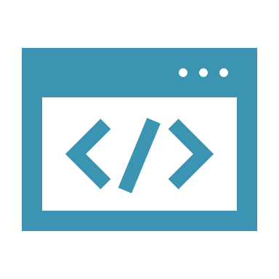
Front-end of the Project
Tkinter: Tkinter is a Python library for building graphical user interfaces. It provides a range of widgets (such as buttons, labels, text entry fields, and frames) to create the application's interface. In this project, Tkinter is used to create the login screens, tabbed interfaces, input fields, buttons, and display areas for patient and doctor interactions.
Ttk (Themed Tkinter): Ttk is a module within Tkinter that provides themed widget sets. It is used to enhance the look and feel of the application by providing a more modern and attractive appearance to the GUI elements.
Notebook: The ttk.Notebook widget is used to create a tabbed interface, allowing the user to switch between different sections of the application (such as "Add Patient," "Search Patients," "Generate Report," etc.) with ease.
Buttons and Entry Fields: Various buttons are used to trigger actions like logging in and submitting data. Entry fields are provided for users to input data such as usernames, passwords, patient details, and medical reports.
Text and Text Widgets: Text widgets are used to display detailed information, such as patient details and medical reports.

Slide 6
Back-end of the Project
SQLite Database: The backend uses an SQLite database named "medical_app.db" to store and manage data related to doctors, patients, and medical reports. SQLite is a lightweight, serverless, and self-contained database engine, making it suitable for small to medium-scale applications.
Database Operations: The code includes functions for database operations, such as inserting patient records, searching for patients, updating patient information, and submitting medical reports. These functions interact with the database to perform CRUD (Create, Read, Update, Delete) operations.
Data Validation: The backend includes data validation to ensure that data entered by users is accurate and appropriate. For example, it checks for valid doctor or patient IDs before updating records.
Exception Handling: The backend includes exception handling to manage errors, such as database connection issues, and provide appropriate error messages to the user.
Database Retrieval: The backend retrieves and processes data from the database to display patient details and generate patient reports.
User Authentication: The backend is responsible for user authentication by verifying the entered username and password against the stored credentials in the database.

Slide 7

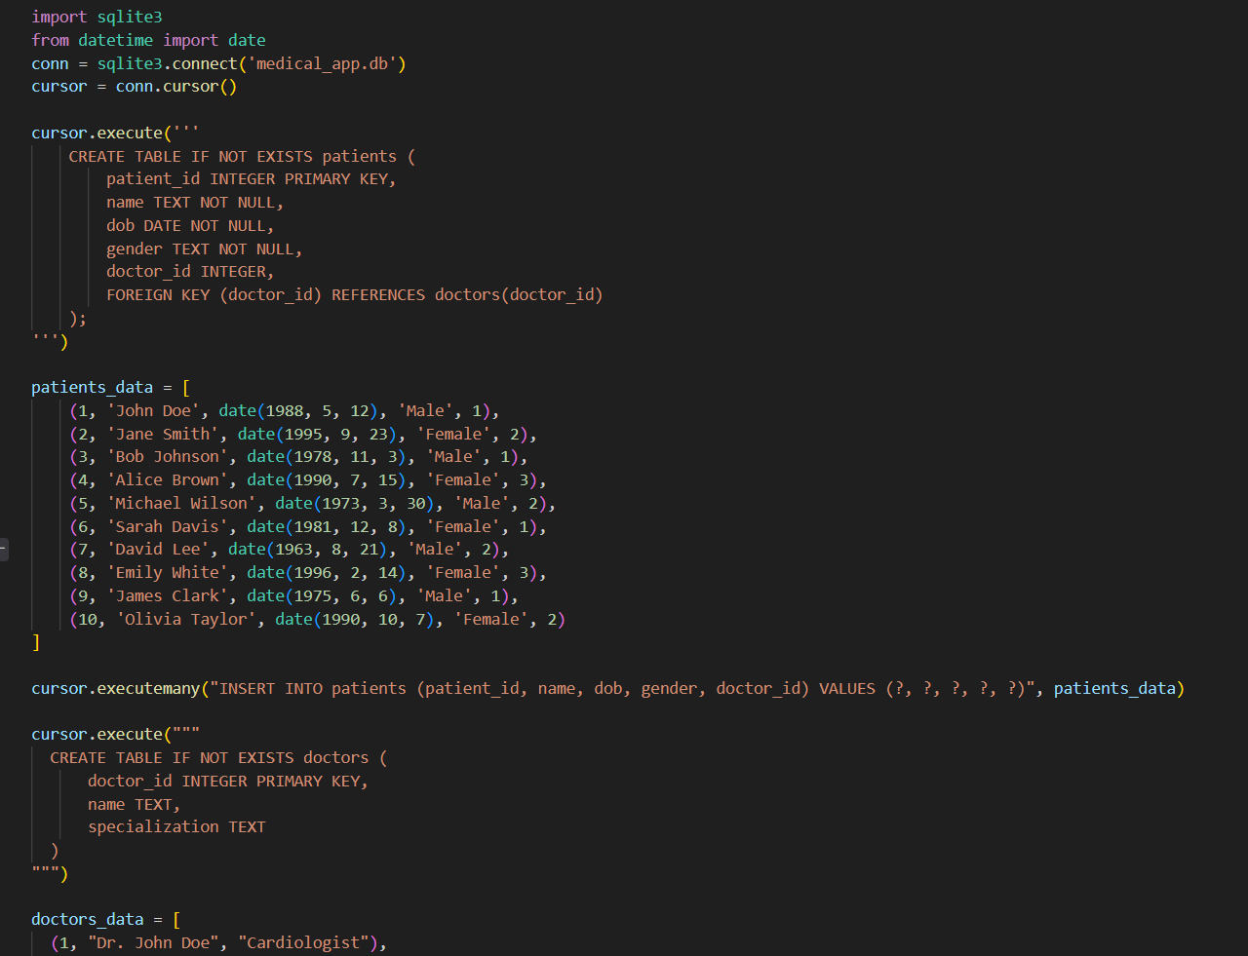
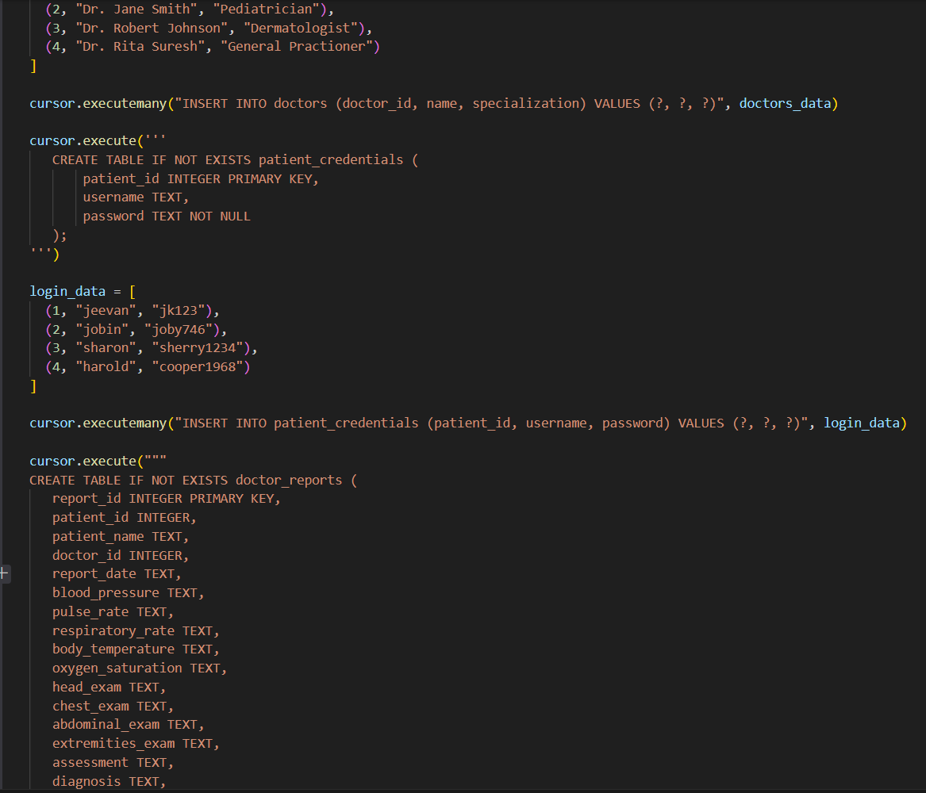
Source Code

Slide 8
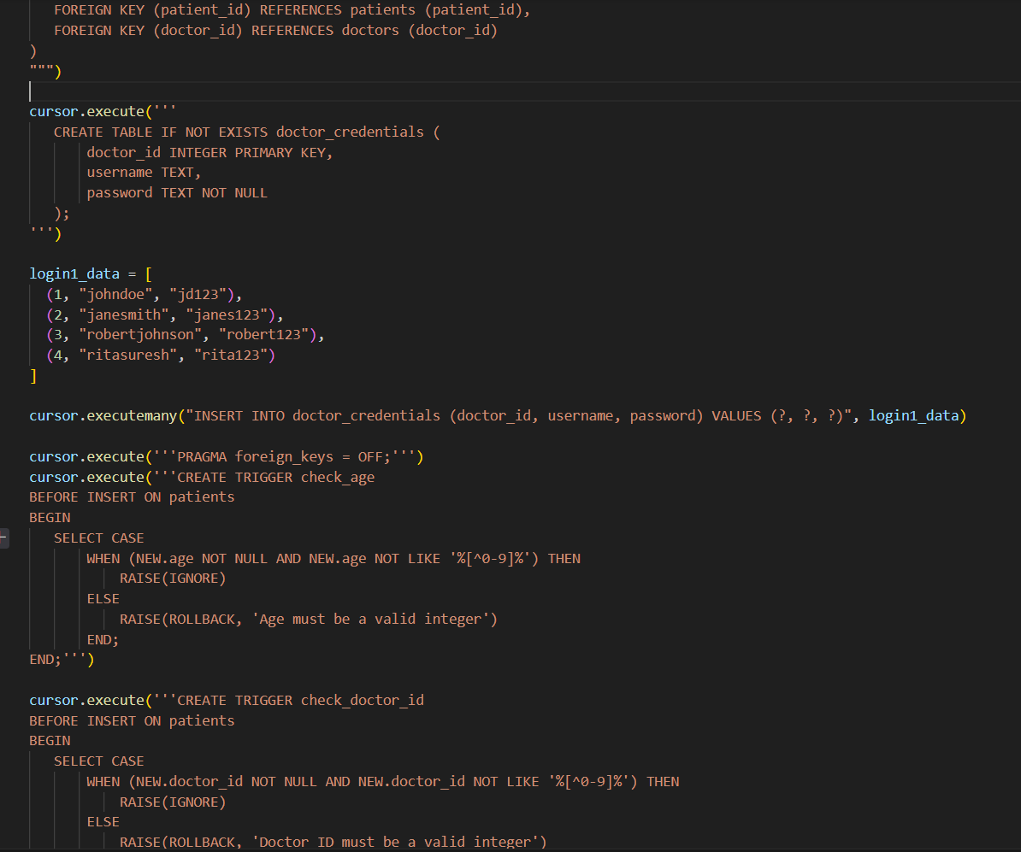
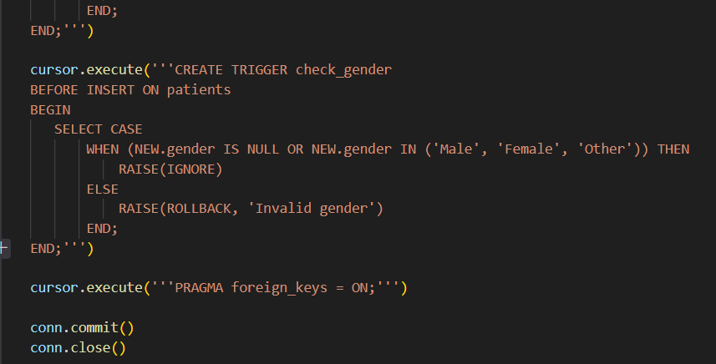
This creates the database schema

Slide 9
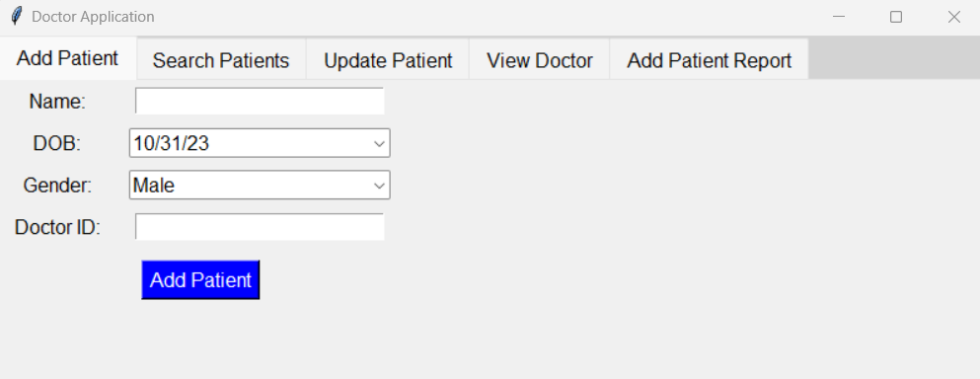
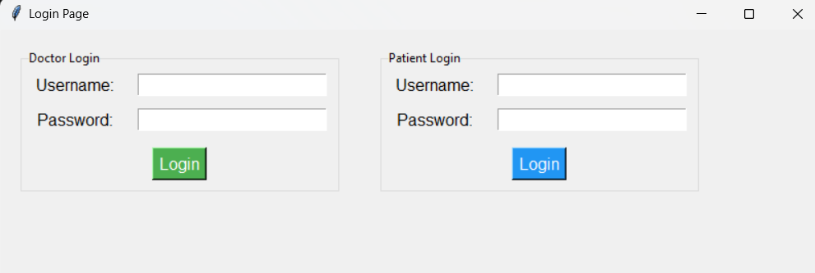
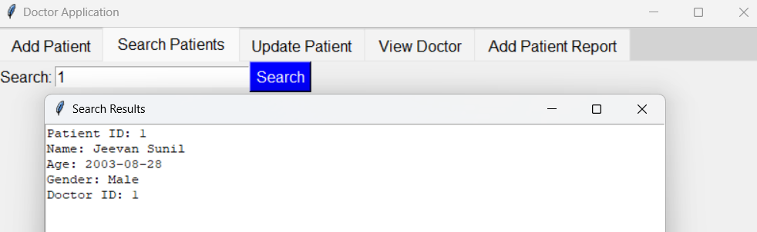
Output

Slide 10
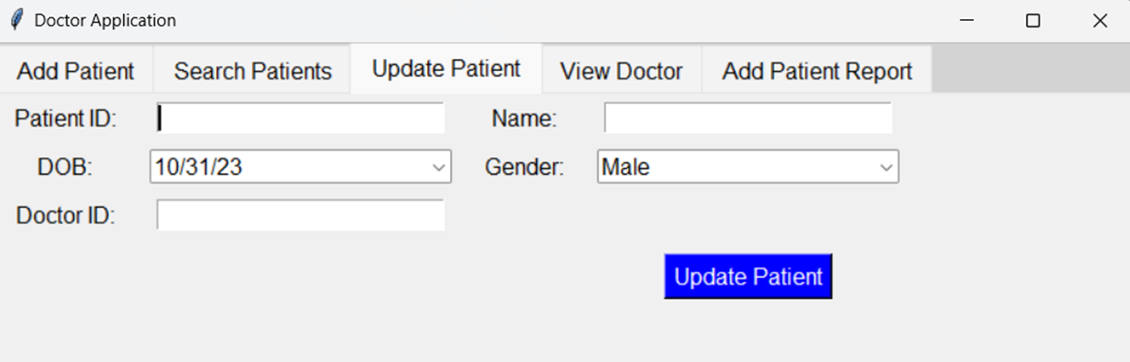
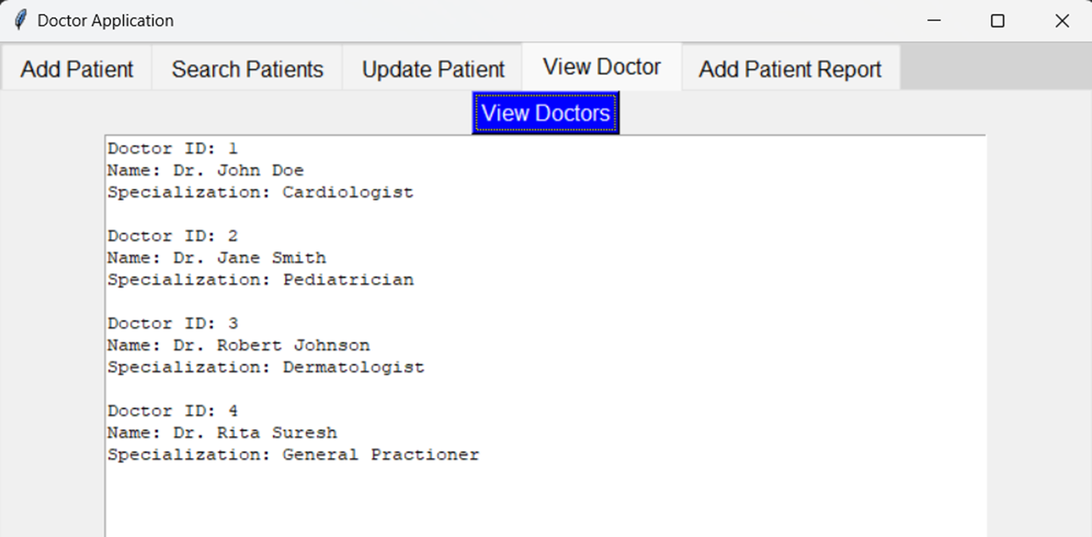
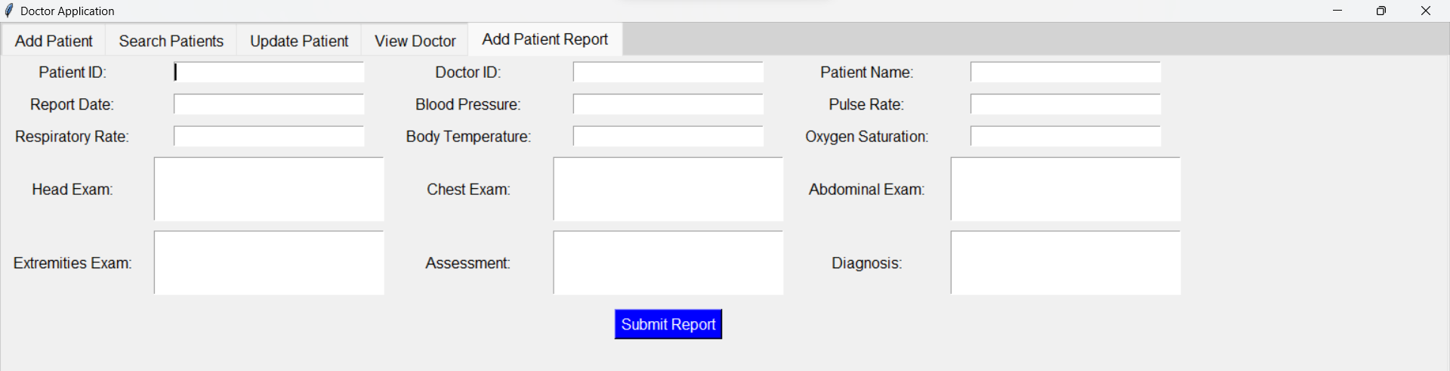

Slide 11
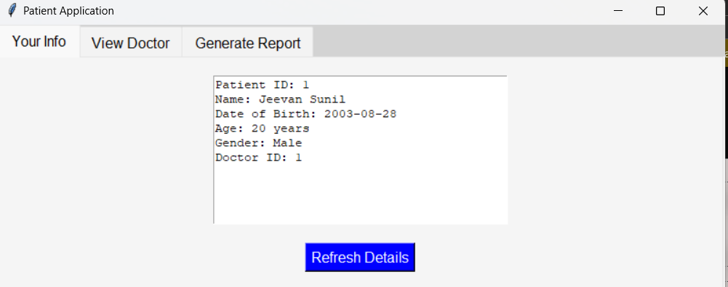
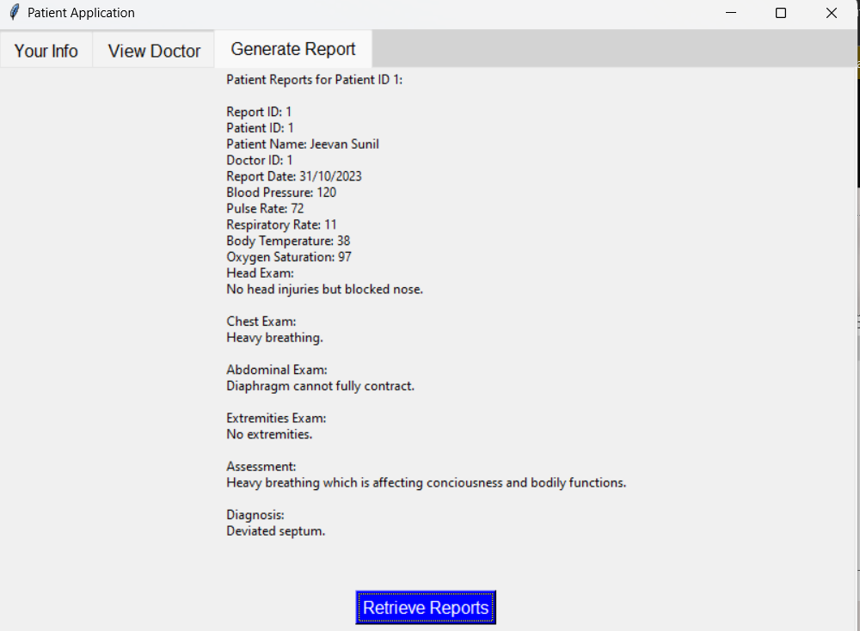
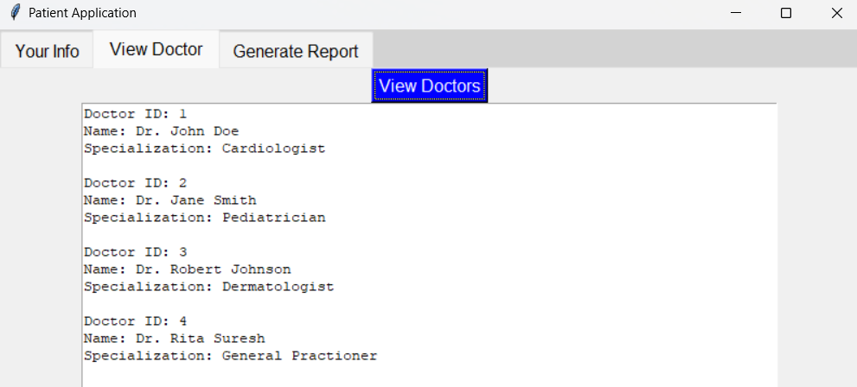

Slide 12
THANK YOU!

